Slide 1
Bug Tracing System

Slide 2
Content
Introduction
Application Features
UI Snapshots
Concepts & Tools
Team Members

Slide 3
Introduction
The project is an online bug tracking system for projects. The application allows software testers to report bugs for a project, project managers to view all bugs, assign bugs to developers and developers to update the bug status.

Slide 4
Content & Tools
Github
Code Hosting: You can host your Git repositories on GitHub, making it easy to store and share your code with others. GitHub provides reliable and scalable infrastructure for hosting projects of all sizes.
Collaboration: GitHub is designed for collaboration. You can work with other developers on the same project, contribute to open-source projects, and easily manage contributions from multiple contributors.
Pull Requests: GitHub's pull request feature enables developers to propose changes ta project's codebase. This allows for code review, discussions, and a structured way to integrate new features or bug fixes.
Code Review: GitHub provides a rich code review experience with features like inline comments, the ability to compare changes, and the option to leave feedback on specific lines of code. This helps maintain code quality.

Slide 5
Front-End
HTML
HTML is a markup language used to create and format documents on the World Wide Web. It consists of a set of elements enclosed in angle brackets ("<" and ">") that define the structure and content of a web page. Each HTML element serves a specific purpose, and web browsers interpret these elements to display web content.
CSS
CSS, which stands for Cascading Style Sheets, is a stylesheet language used for describing the presentation and visual formatting of web documents written in HTML and XML. It is an essential technology for web development as it separates the content (HTML or XML) from its presentation (styles) and allows developers to control the layout, appearance, and design of web pages.

Slide 6
JAVASCRIPT
JavaScript is a high-level, versatile, and widely used programming language primarily known for its role in web development. It is an integral part of modern web applications, allowing developers to add interactivity, manipulate the Document Object Model (DOM), and create dynamic content on websites.

Slide 7
Back-End
JAVA
Java is a popular choice for backend development, especially for building server-side applications, web services, and microservices. Its scalability, performance, and robustness make it well-suited for handling backend logic and data processing.

Slide 8
Team Member
FRONT-END
1.AKASH K.R
2.KARTAVYA CHAUHAN
3.SUNISHA RAINA
4.VEDANGI DHOLE
BACK-END
1.ASHUTOSH DUBEY
2.ANSHITA JAIN
3.SHIVANI SHIRALE
4.VAIBHAI MEKHE

Slide 9
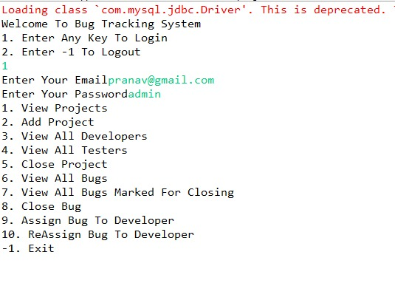
Project Manager Control

Slide 10
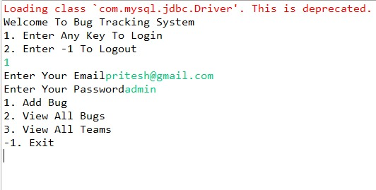
Tester Control

Slide 11
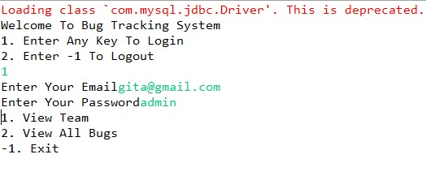
Developer Control

